Slide 1


MOBILE SCHOOL MANAGEMENT SYSTEM
Burak Emrullah GÜNEŞ – 201611026
Oğuz GÜL – 201411025
Furkan TÜRKMEN – 201511064
Advisor : Murat SARAN, Assist. Prof. Dr.
Murat ŞANLISAVAŞ - 201011302

Slide 2

Contents
Project Information
Problem
Objectives
Analysis
Solution
Results and Conclusion
References
Demo

Slide 3

project Informatıon
The systems used in our project consist of three architectural layers: Web API, Web Admin Panel and Web User Panel. The Web API in these layers communicates with the database tables and processes data capture for the other two panels. The other two Web Panels communicate with the database through this Web API. In this way, the web Admin Panel performs all CRUD operations. In the same way, the Web User Panel also has three types of user types, which are student, teacher, and parent. These types of users perform their work through the system using functions that are specific to them. In doing so, it communicates with the database through the Web API and performs operations in the background.

Slide 4

Problem
Today's web-supported and mobile education platforms do not provide adequate use. MSMS incorporates many features in this area. Interactive education systems on the market are used for their own institution, while MSMS can serve multiple profiles in such institutions.

Slide 5

Objectives
MSMS aims to cover multiple areas in School Management System.
In order to eliminate deficiency in areas such as contacting other users of the system or just simply contacting a classes teacher MSMS provides some features to overcome this difficulties.

Slide 6

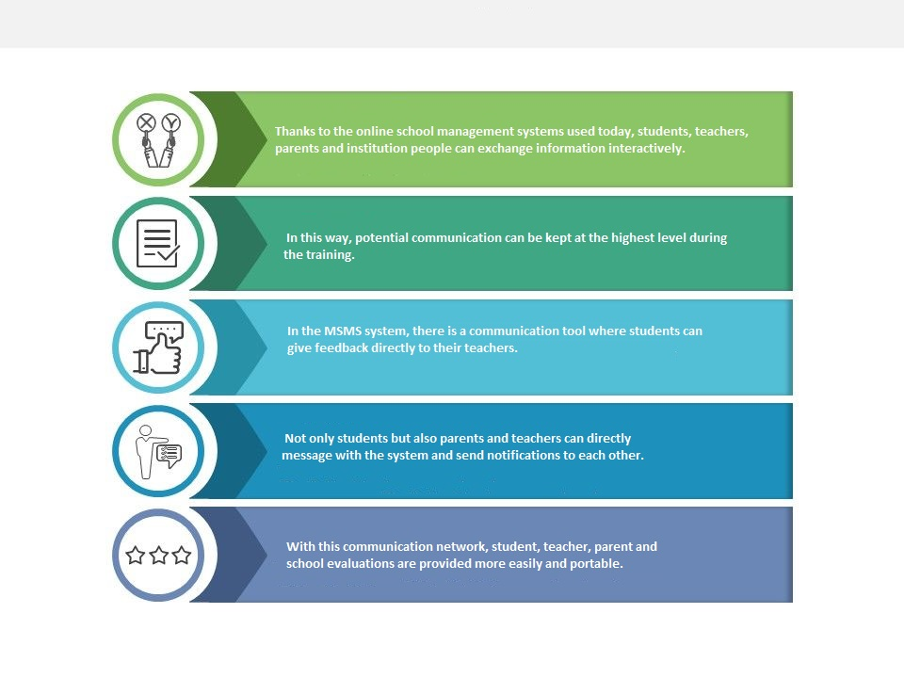
Analysis

Slide 7
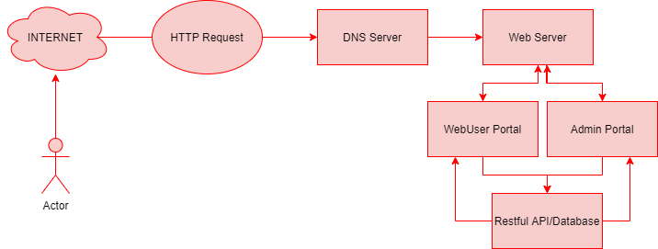
Solutıon: System Design

Slide 8
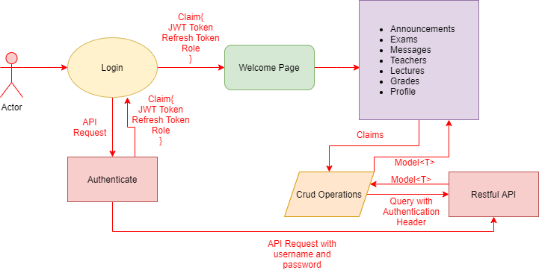
SOLUTION: Webuser portal example Data flow

Slide 9
SOLUtıon: technologıes
Back-end
Asp.net Core 3.14
MVC Core along with Entity Framework Core 3.14
Json Web Token
Javascript
Front-end
Bootstrap v4.3.1
Font-Awesome
Many javascript libraries
Razor with Html Helpers
Database
Microsoft SQL Server

Slide 10
ADvantages
Pre-processed Information
Secure
Easily Integratable
Multiple Interface

Slide 11
Dısadvantages
Parent and Teacher Oriented

Slide 12

Demo

Slide 13
Thank You !
Any Questions?

